Slide 1

BANK MANAGEMENT SYSTEM
PROJECT DESCRIPTION:
This project focuses on implementing a banking system using fundamental concepts of Data Structures and Algorithms (DSA). It demonstrates how different data structures can be used to organize, store, and process banking data in an efficient and structured manner.
Arrays are used to store fixed-size data such as account numbers, branch codes, interest rates, transaction limits, and account types, providing fast and direct access to records. Linked Lists are utilized for managing dynamic data like transaction history and loan records, allowing efficient insertion and deletion without data shifting.
Stacks are implemented to support undo and redo operations during transactions, ensuring data safety and recovery in case of errors. Queues are used to handle customer service requests and loan processing in a fair and systematic manner following the FIFO principle.
Additionally, searching algorithms such as Linear Search and Binary Search are used to quickly locate account and transaction details. Sorting algorithms help organize data for better analysis, such as sorting customers by balance or transactions by date.
Overall, this project highlights how DSA concepts can be applied to build a reliable, efficient, and scalable banking system that improves performance and ensures accurate data management.

Slide 2
BANK MANAGEMENT SYSTEM
Team Members
Hanish reddy -2510030290
Abhilash-2510030231
Vineeth reddy-2510030240
Siddharth -2510030423
Sai Varun reddy-2510030021
Arun -2510080062(04)
Varun reddy-2510040076(04)

Slide 3
Modules
1. Account Management
2. Search
3. Sorting
4. Transactions
5. Undo

Slide 4
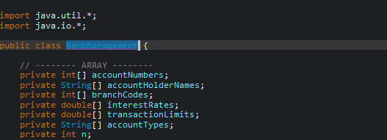
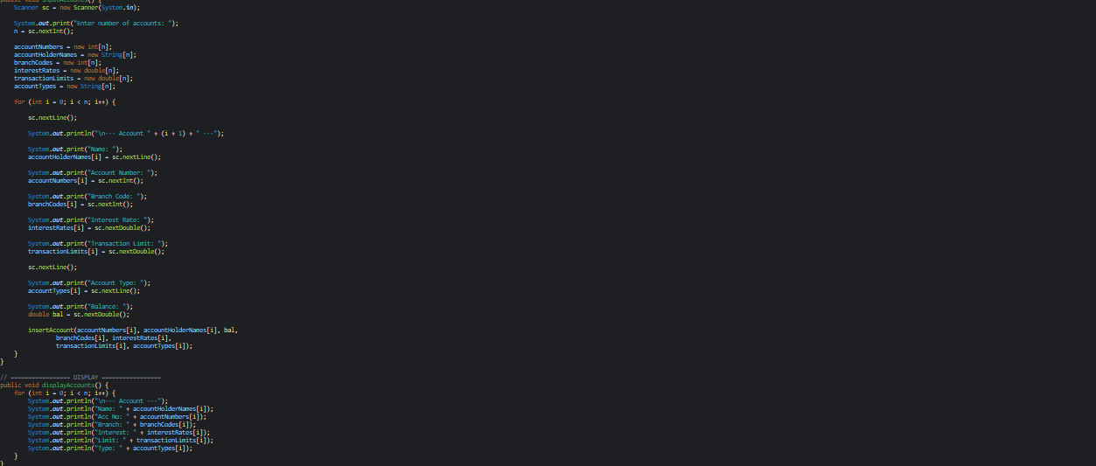
Account Management
Stores account details using arrays.
Input and display accounts.
Fields: Acc No, Branch, Interest, Limit, Type

Slide 5
Search & Sorting
Linear Search for unsorted data
Binary Search after sorting
Bubble Sort for sorting accounts

Slide 6
Transaction Module
Linked List for transactions
Dynamic storage
Add and display transactions

Slide 7
Stack Module
Stack used for undo operation
Push and pop operations
Maintains transaction history

Slide 8
Risks and Gap
Consumers/ users may think that they are rich enough to not install the solar panels. So we have to keep upgrading.
Low sunlight areas
Cleaning of solar panels time to time to not reduce the performance

Slide 9


